Slide 1
XML

Slide 2
What is XML?
XML: a "skeleton" for creating markup languages
You already know it!
Syntax is identical to XHTML's:
<element attribute="value">content</element>

Slide 3
What is XML?
Languages written in XML specify:
Names of tags in HTML: h1, div, img, etc.
Names of attributes in HTML: id/class, src, href, etc.
Rules about how they go together in HTML: inline vs. block-level elements

Slide 4
Why do we need XML?
To present complex data in human-readable form
XML is "self-describing data”
Plain text format that is independent of storing, transporting, and sharing data
Notes:
Simplicity, organization, accessibility, standardization, multiple applications

Slide 5
Anatomy of an XML file
<?xml version="1.0" encoding="UTF-8"?> <!-- XML prolog -->
<note> <!-- root element -->
<to>Tove</to>
<from>Jani</from> <!-- element ("tag") -->
<subject>Reminder</subject> <!-- content of element -->
<message language="english"> <!-- attribute and its value -->
Don't forget me this weekend!
</message>
</note> XML
Begins with an <?xml ... ?> header tag ("prolog")
Has a single root element (in this case, note)
tag, attribute, and comment syntax is just like HTML

Slide 6
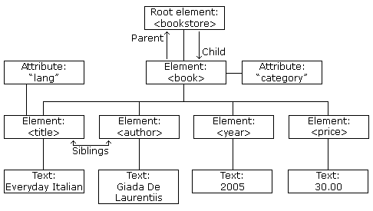
Anatomy of an XML file

Slide 7
Uses of XML
XML data comes from many sources on the web:
Web servers store data as XML files
Databases sometimes return query results as XML
Web services use XML to communicate
XML is the universal format for exchange of data
XML languages are used for music, math, vector graphics
Popular use: RSS for news feeds & podcasts

Slide 8
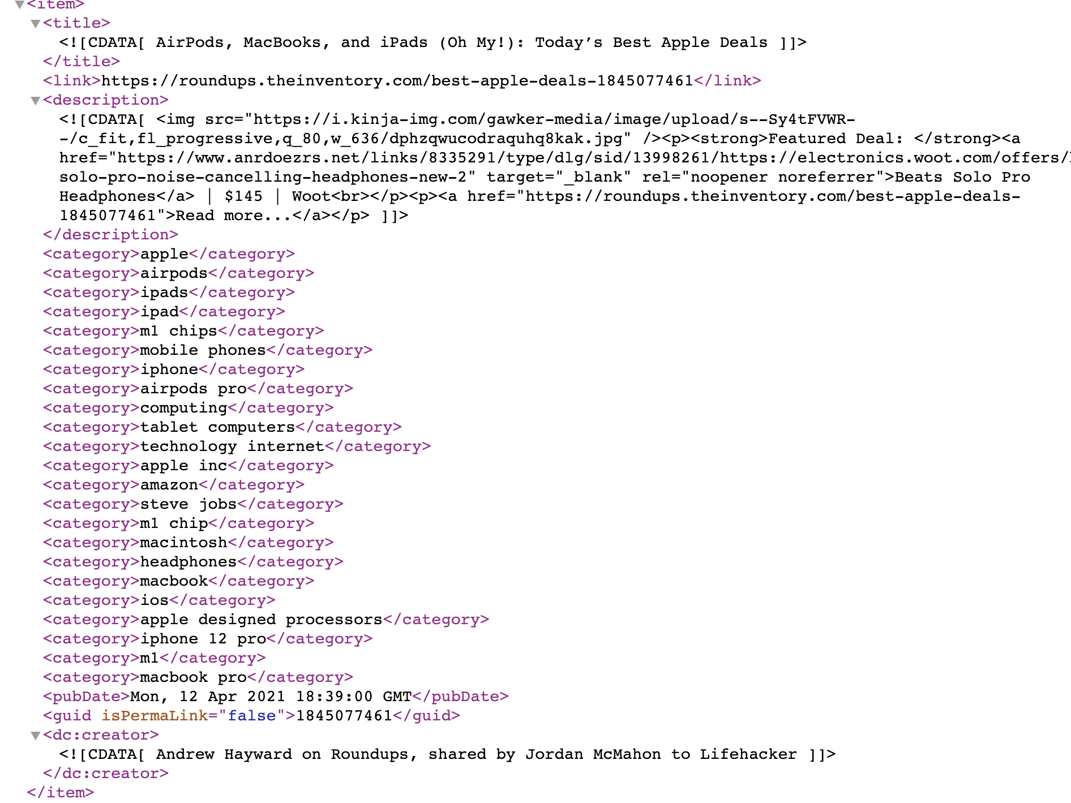
Uses of XML – RSS feed

Slide 9
Pros and Cons of XML
Pros:
Easy to read (for humans and computers)
Standard format makes automation easy
Don't have to "reinvent the wheel" for storing new types of data
International, platform-independent, open/free standard
Can represent almost any general kind of data (record, list, tree)

Slide 10
Pros and Cons of XML
Cons:
Bulky syntax/structure makes files large; can decrease performance
Example: quadratic formula in MathML
Can be hard to "shoehorn" data into a good XML format

Slide 11
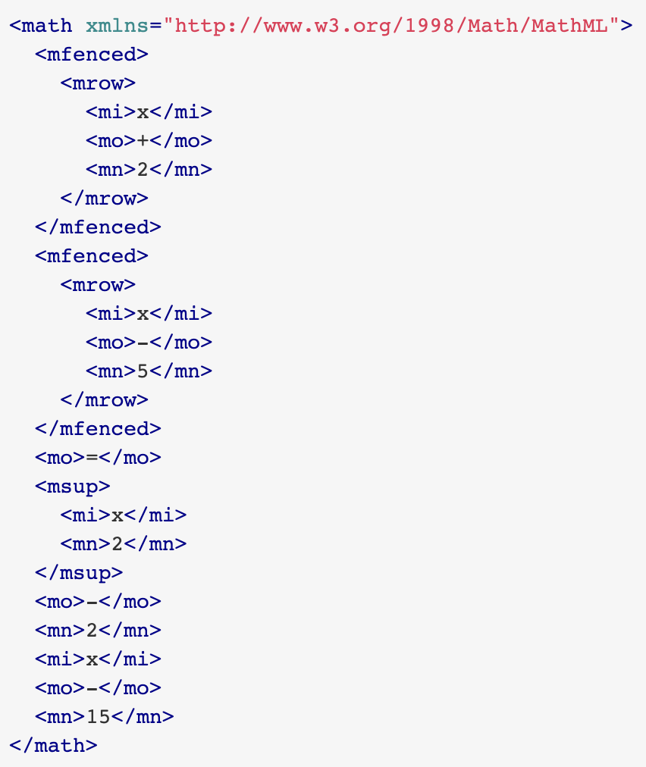
MathML Example

Slide 12
What tags are legal in XML?
Any tags you want!
Examples:
An email message might use tags called to, from, subject
A library might use tags called book, title, author
When designing an XML file, you choose the tags and attributes that best represent the data
Rule of thumb: data = tag, metadata = attribute

Slide 13
Doctypes and Schemas
“Rule Books” for individual flavors of XML
List which tags and attributes are valid in that language, and how they can be used together
Used to validate XML files to make sure they follow the rules of that "flavor"
the W3C HTML validator uses the XHTML doctype to validate your HTML
For more info:
Document Type Definition (DTD) ("doctype")
W3C XML Schema

Slide 14
XML and AJAX
Web browsers can display XML files, but often you instead want to fetch one and analyze its data
The XML data is fetched, processed, and displayed using AJAX
(XML is the "X" in ”AJAX")

Slide 15
XML and AJAX
It would be very clunky to examine a complex XML structure as just a giant string!
Luckily, the browser can break apart (parse) XML data into a set of objects
There is an XML DOM, very similar to the (X)HTML DOM

Slide 16
XML DOM Tree Structure
<?xml version="1.0" encoding="UTF-8"?>
<categories>
<category>children</category>
<category>computers</category>
...
</categories> XML
The XML tags have a tree structure
DOM nodes have parents, children, and siblings

Slide 17
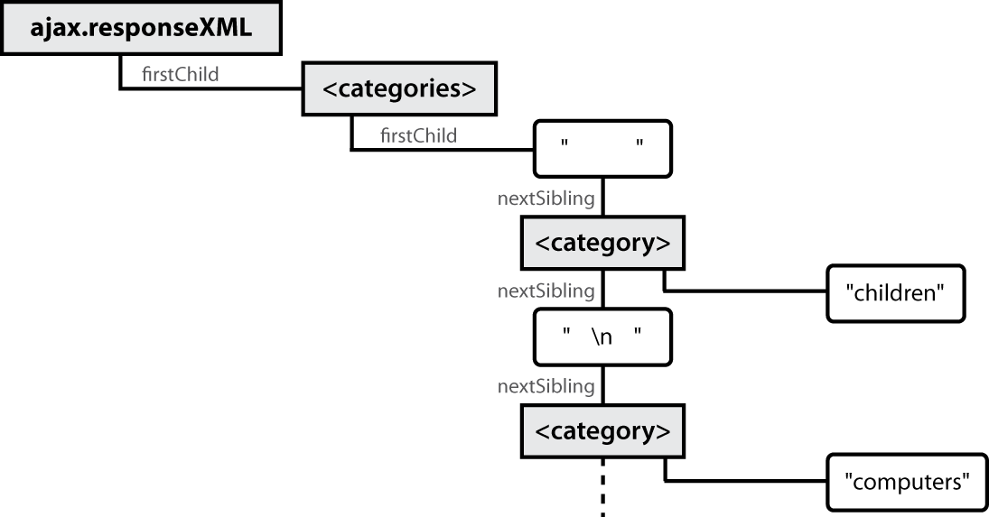
XML DOM tree structure

Slide 18
Recall: Javascript XML (XHTML) DOM
The DOM properties and methods we already know can be used on XML nodes:
Properties:
firstChild, lastChild, childNodes, nextSibling,
previousSibling, parentNode
nodeName, nodeType, nodeValue, attributes
Methods:
appendChild, insertBefore, removeChild, replaceChild
getElementsByTagName, getAttribute, hasAttributes, hasChildNodes
Caution: cannot use HTML-specific properties like innerHTML in the XML DOM!

Slide 19
Navigating the Node Tree
Caution: can only use standard DOM methods and properties in XML DOM
HTML DOM has Prototype methods, but XML DOM does not!
Caution: can't use ids or classes to get specific nodes
id and class are not necessarily defined as attributes in the flavor of XML being read

Slide 20
Navigating the Node Tree
Caution: firstChild/nextSibling properties are unreliable
Annoying whitespace text nodes!
The best way to walk the XML tree:
var elms = node.getElementsByTagName("tagName")
Returns an array of all node's children of the given tag name
node.getAttribute("attributeName")
Gets an attribute of an element

Slide 21
Using XML data in a web page
Procedure:
Use Ajax to fetch data
Use DOM methods to examine XML:
XMLnode.getElementsByTagName()
Extract the data we need from the XML:
XMLelement.getAttribute(), XMLelement.firstChild.nodeValue, etc.

Slide 22
Using XML data in a web page
Create new HTML nodes and populate with extracted data:
document.createElement(), HTMLelement.innerHTML
Inject newly-created HTML nodes into page
HTMLelement.appendChild()

Slide 23
Fetching XML using AJAX (template)
new Ajax.Request(
"url",
{
method: "get",
onSuccess: functionName
}
);
...
function functionName(ajax) {
do something with ajax.responseXML;
} JS
ajax.responseText contains the XML data in plain text
ajax.responseXML is a pre-parsed XML DOM object

Slide 24
Analyzing a fetched XML file using DOM
<?xml version="1.0" encoding="UTF-8"?>
<foo bloop="bleep">
<bar/>
<baz><quux/></baz>
<baz><xyzzy/></baz>
</foo> XML
We can use DOM properties and methods on ajax.responseXML:
// zeroth element of array of length 1
var foo = ajax.responseXML.getElementsByTagName("foo")[0];
// ditto
var bar = foo.getElementsByTagName("bar")[0];
// array of length 2
var all_bazzes = foo.getElementsByTagName("baz");
// string "bleep"
var bloop = foo.getAttribute("bloop"); JS

Slide 25
Larger XML file example
<?xml version="1.0" encoding="UTF-8"?>
<bookstore>
<book category="cooking">
<title lang="en">Everyday Italian</title>
<author>Giada De Laurentiis</author>
<year>2005</year><price>30.00</price>
</book>
<book category="computers">
<title lang="en">XQuery Kick Start</title>
<author>James McGovern</author>
<year>2003</year><price>49.99</price>
</book>
<book category="children">
<title lang="en">Harry Potter</title>
<author>J K. Rowling</author>
<year>2005</year><price>29.99</price>
</book>
<book category="computers">
<title lang="en">Learning XML</title>
<author>Erik T. Ray</author>
<year>2003</year><price>39.95</price>
</book>
</bookstore> XML

Slide 26
Navigating node tree example
// make a paragraph for each book about computers
var books = ajax.responseXML.getElementsByTagName("book");
for (var i = 0; i < books.length; i++) {
var category = books[i].getAttribute("category");
if (category == "computers") {
// extract data from XML
var title =
books[i].getElementsByTagName("title") [0].firstChild.nodeValue;
var author = books[i].getElementsByTagName("author")[0].firstChild.nodeValue;
// make an XHTML <p> tag containing data from XML
var p = document.createElement("p");
p.innerHTML = title + ", by " + author;
document.body.appendChild(p);
}
} JS

Slide 27
Resources
http://www.sitepoint.com/really-good-introduction-xml/
http://www.w3.org/XML/Schema.html

